Slide 1
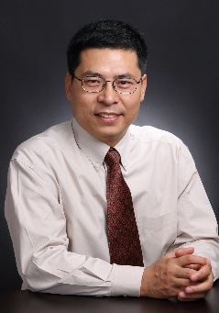
稀土纳米功能(光、磁、催化)材料
学科带头人：郑智平 南方科技大学 化学系 讲座教授
国家“千人计划”特聘专家
Education & Professional Background
2017-present Chaired Professor, Southern University of Science and Technology
2011-2016 Director, Center for Applied Chemical Research, Founding Chair,
Frontier Institute of Chemistry, Xi’an Jiaotong University
2006-2012 “Minjiang Scholar” Guest Professor, Xiamen University
1997-2017 Assistant, Associate, and Full Professor, University of Arizona
1995-1997 Postdoctoral Associate, Harvard University
1991-1995 Graduate Student (Ph.D. 1995), University of California, Los Angeles
1983-1990 Student at Peking University (M.S. 1990; B.S. 1987)
Research Interests
1）coordination chemistry, organometallic chemistry
2）luminescent and magnetically active lanthanide complexes
3）cluster compounds of transition and lanthanide elements
4）cluster-based green catalysts
5）cluster-based light-limiting materials

Slide 2
稀土纳米功能(光、磁、催化)材料
学科带头人：郑智平 南方科技大学 化学系 讲座教授
国家“千人计划”特聘专家
Honors
• Being elected as Fellow of the Royal Chemical Society (2016)
• National "Thousand Talents Program" Distinguished Professor（2011） • Excellence in Teaching, University of Arizona(2007) • Young Observer, International Union of Pure and Applied Chemistry（2005) • International Junior Award, European Rare Earth and Actinide Society（2003) • US NSF CAREER Award（2003） • China Bridges International Fellowship (1999) • Research Corporation Innovation Award（1998) • Outstanding Dissertation Award(Inorganic Chemistry, UCLA(1995) • Ralph Bauer Prize for Excellence in Research, UCLA(1994) • Graduate Achievement Award, UCLA(1994)
A leader in the coordination chemistry of the lanthanide elements, in particular that of cluster-type polynuclear lanthanide complexes.
Topic Editor for Crystal Growth and Design and is now on the Advisory Board.
On the Editorial Board of Inorg. Chem. Frontiers, and is an Overseas Managing Editor for Journal of Rare Earths.

Slide 3

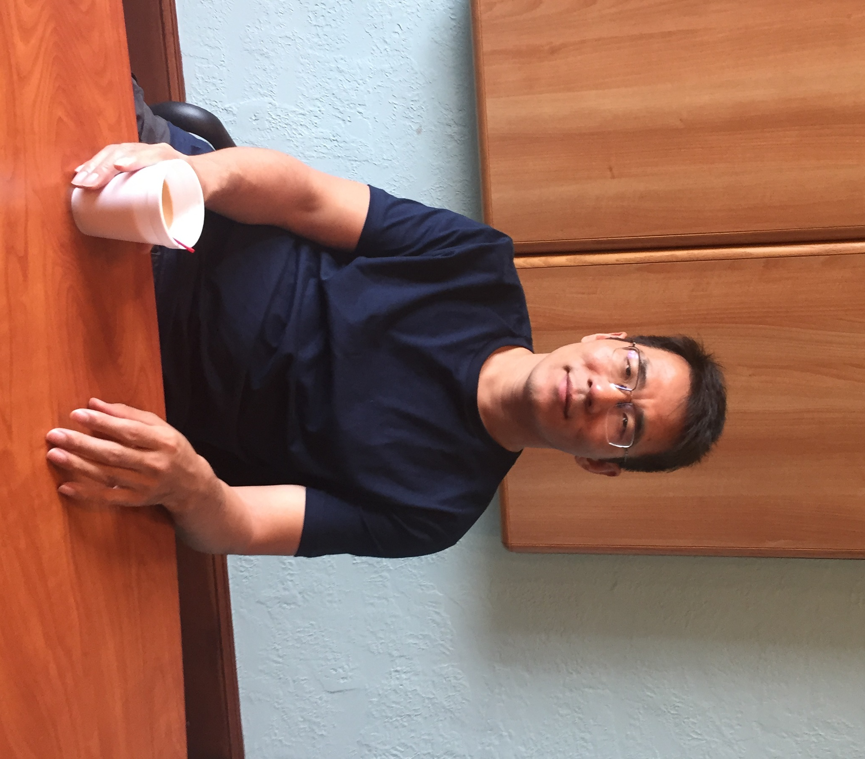
Composite Functional
Molecular Magnetic Materials (CFM3)
Education and Research Background
2015-Present | Assoc. Prof., Southern Univ. of Science and Technology
2013-2015 | Senior research scientist (Prof. Dunbar), Texas A&M Univ.
2007-2013 | Post-doc (Prof. S. M. Holmes), Univ. of Kentucky/ Univ. of Missouri-St. Louis, USA
2006-2007 | Post-doc (Prof. P. Coppens), State Univ. of NY at Buffalo
2005-2006 | Post-doc (Prof. O. Sato), Kyushu Univ., Japan
1996-2005 | B.S and Ph.D. (Supervisor: Prof. Song Gao), PKU.
Dr. Yuan-Zhu Zhang
Honors & Awards
2017 Overseas High-Caliber Personnel (Level B) in Shenzhen (Peacock Plan)
2016 The 8th Recruitment Program of Global Experts (Youth¹⁰⁰⁰ Talents Program)
Nominee Award for National Top¹⁰⁰ Excellent Ph.D Thesis
2005 Innovation Award, and Excellent Ph.D Thesis Award (Peking University)

Slide 4
CFM3 Group
Research Interests
Molecule-based Magnets with Bistability: Molecule-based Nanomagnets, thermal active bistable molecular magnets
Molecule-based Photo-Magnets
Functional Molecular Materials combined with SCO and charge transfer behavior
S = 0
S = 1/2
Spin orbital coupling
S = 1/2
Bridge
Auxiliary
Representative Publications
Spin carrier
Chem. Sci. 2018, 9, 119;
Chem. Sci. 2016, 7, 6519;
J. Am. Chem. Soc. 2017, 139, 11714;
J. Am. Chem. Soc. 2014, 136, 16854;
Angew. Chem. Ed. Int. 2015, 54, 5583;
Angew. Chem. Ed. Int. 2010, 49, 3752；
Angew. Chem. Ed. Int. 2005, 44, 5841.
Self-
Assembly
Directional
Assembly
Functional
Molecular Magnets

Slide 5
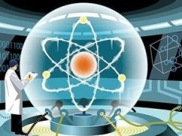
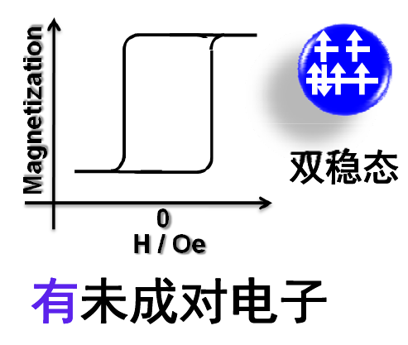
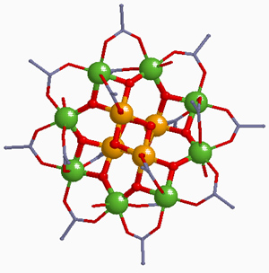
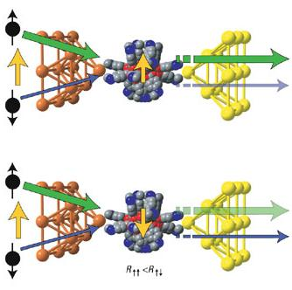
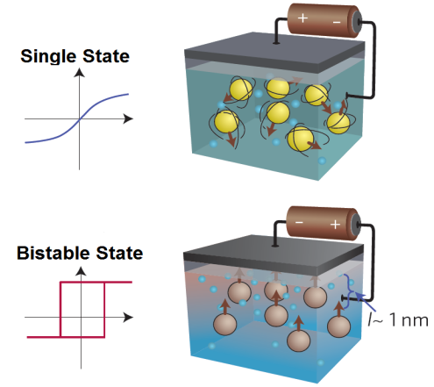
Research Interests
Applications
Molecular Nanomagnets (Single Ion/Molecule/Chain Magnets)
I
II
Quantum Computing
Field
ΔE = ⏐D⏐S²
Nature 1993
Room-Temperature Bistable Materials (SCO、Electron-Transfer）
I
Molecular Spin Electronics
II
T_{1/2}
Temperature
Bistable Materials
Notes:
我的主要研究内容是双稳态分子磁性材料：低温的分子纳米磁体即单分子磁体和单链磁体，他们对磁场产生双稳态相应，双稳态能垒的大小取决于分子的单轴各向异性D和自旋基态S；电子转移材料主要是对温度产生相应，具有热致、光致的双稳态。我们的研究目标就是要提高分子纳米磁体的能垒；控制电子转移的发生温度。下面向各位专家汇报我在这些方面取得的一些代表性工作。

Slide 6

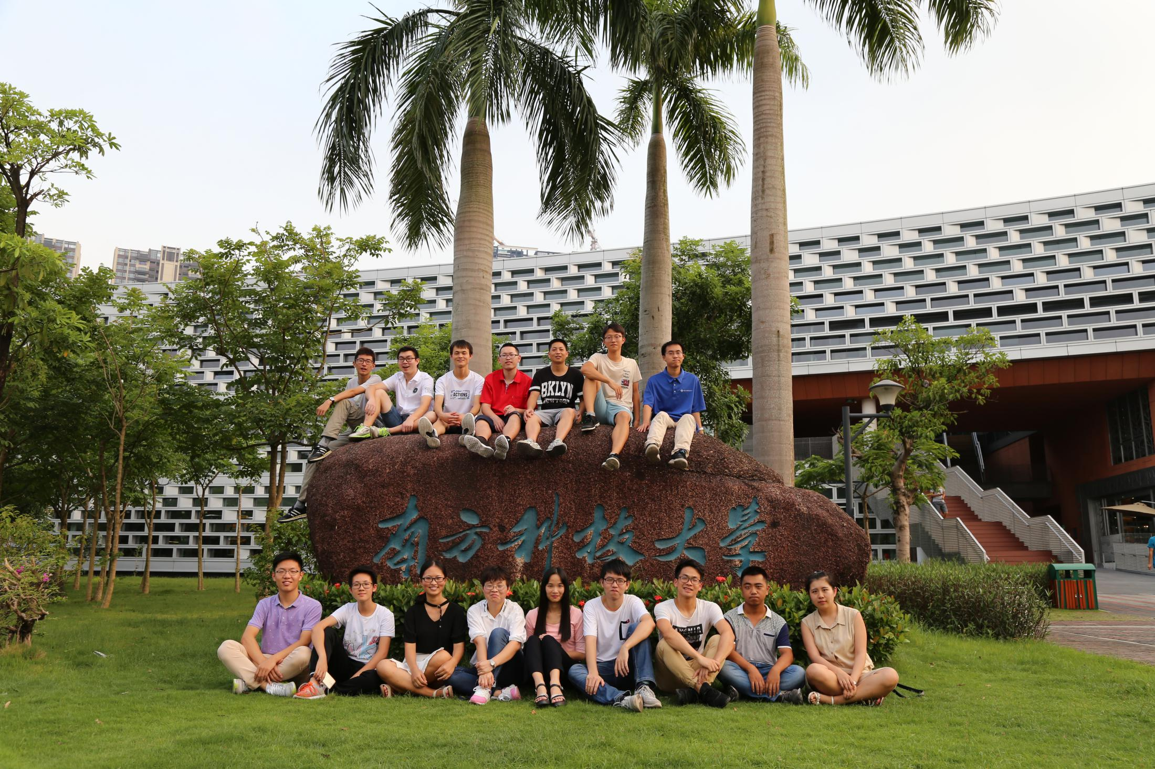
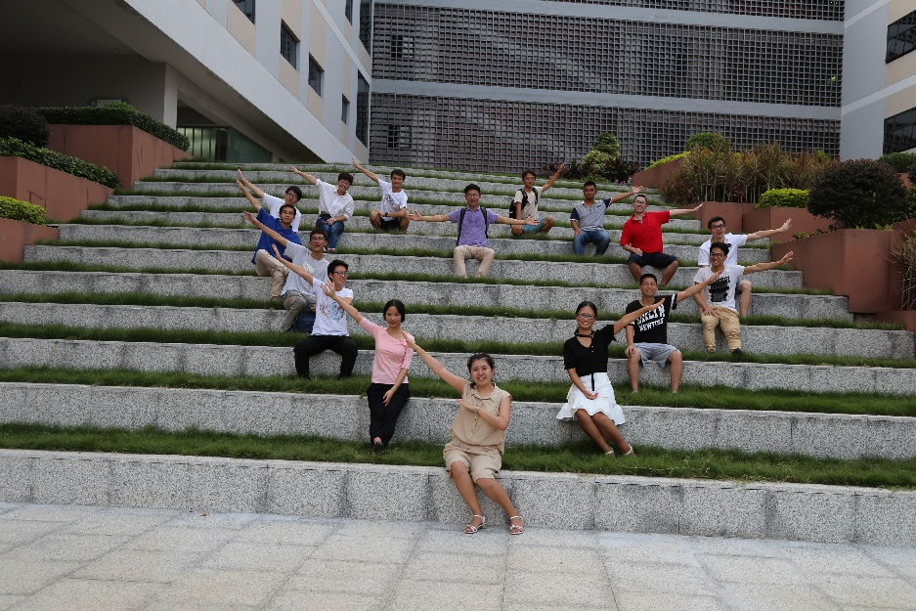
CFM3 Group
张元竹
复合功能分子磁性材料
南方科技大学
慧园6栋205 zhangyz@sustc.edu.cn
13728626921

Slide 7
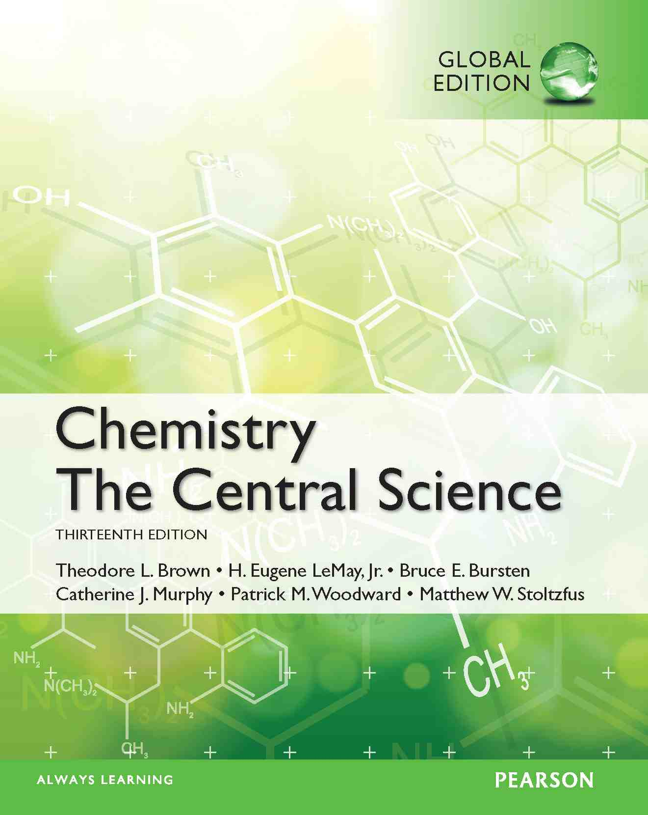
Notes:
科学的中心 多种 可讨论

Slide 8
Exams and Grading
Each week, quiz and homework assignment may be given
Midterm and final exams will be given
At the end of the semester, every student should turn in an essay with free topics on chemistry
Final course credit will be assigned as following:
10% for performance (attendance, quizzes)
20% for homework assignment
30% for midterm exam
10% for the essay (group project)
30% for the final exams

Slide 9
A level-Lecture Schedule(The below schedule may be subject to change if need)
Week | Dates | Topics
1 | Sep. 3 | Chapter 1: Introduction: Matter and Measurement
1 | Sep. 5 | Chapter 2: Atoms, Molecules and Ions
2 | Sep. 10 | Chapter 3: Stoichiometry Calculations with Chemical Formulas and Equations
2 | Sep. 12 | Chapter 4: Reactions in Aqueous Solution
3 | Sep. 17 and 19 | Chapter 5: Thermochemistry
4, 5 | Sep. 26 and Oct. 8 | Chapter 6: Electronic structure of atoms
5, 6 | Oct. 10 and 15 | Chapter 7: Periodic Properties of the Elements
6, 7 | Oct. 17 and 22 | Chapter 8: Basic Concepts of Chemical Bonding
7, 8 | Oct. 24, 29 and 31 | Chapter 9: Molecular geometry and bonding theories
9 |  | Mid-term examination
Syllabus

Slide 10
A level-Lecture Schedule(The below schedule may be subject to change if need)
Week | Dates | Topics
9 | Nov. 5 | Chapter 11:Liquids and Intermolecular Forces
9 | Nov. 7 | Chapter 13: Properties of solutions
10 | Nov. 12 and 14 | Chapter 14: Chemical Kinetics
11 | Nov. 19 and 21 | Chapter 15: Chemical equilibrium
12 | Nov. 26 and 28 | Chapter 16: Acid-base equilibrium
13 | Dec. 3 and 5 | Chapter 17: Additional aspects of aqueous equilibria
14 | Dec. 10 and 12 | Chapter 19: Chemical thermodynamics
15 | Dec. 17 and 19 | Chapter 20: Electrochemistry
16 | Dec. 24 and 26 | Chapter 23: Transition metals and coordination chemistry
17/18 |  | Final examination

Slide 11
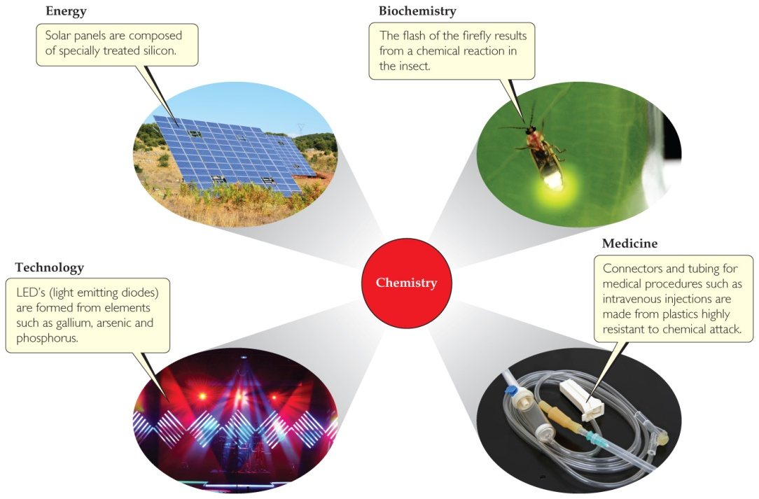
Chemistry: CHEM is try
Chemistry is the study of matter and the changes that it undergoes.
It is central to our fundamental understanding of many science-related fields.
Notes:
Definition 可讨论 bonding, making new substance, macroscopic and microscopic
科学相关的应用的展开 solar cell, firefly, plastics, LED

Slide 12
Matter
Matter is anything that has mass and takes up space.
Air, water, coffee, fire, human beings, and stars are matter. Light, X-rays, photons, information, and love are not matter.
Atoms are the building blocks of matter.
Each element (单质) is made of a unique kind of atom.
A compound (化合物) is made of two or more different kinds of elements.
Notes:
Defination Matter and examples.
Atoms

Slide 13
Methods of Classification
State of Matter （Macroscopic)
Composition of Matter (submicroscopic)

Slide 14
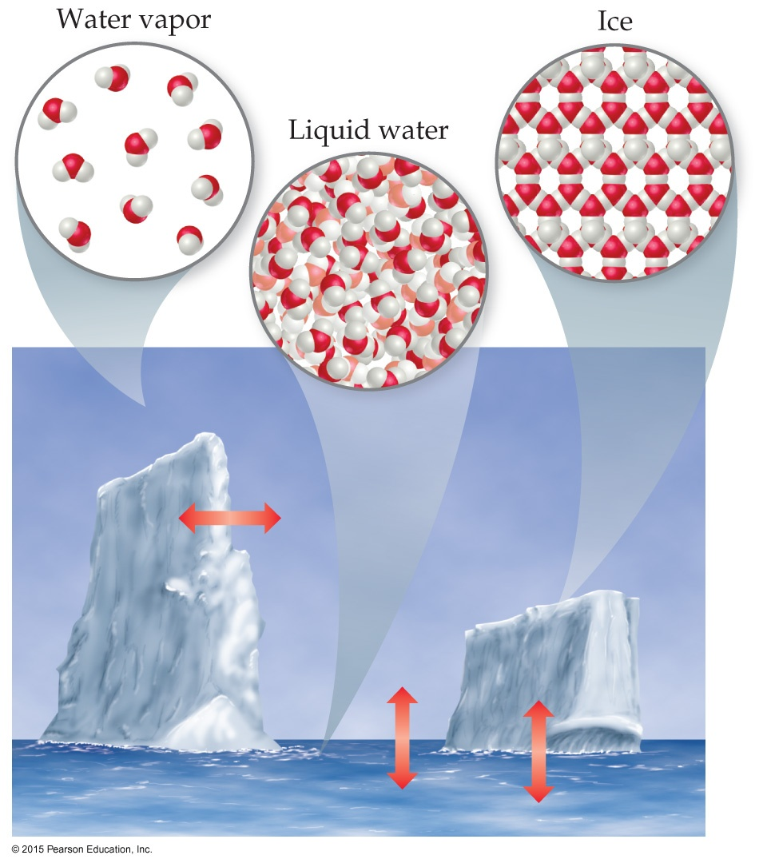
States of Matter
The three states of matter are
solid.
liquid.
gas.
In this figure, those states are ice, liquid water, and water vapor.

Slide 15
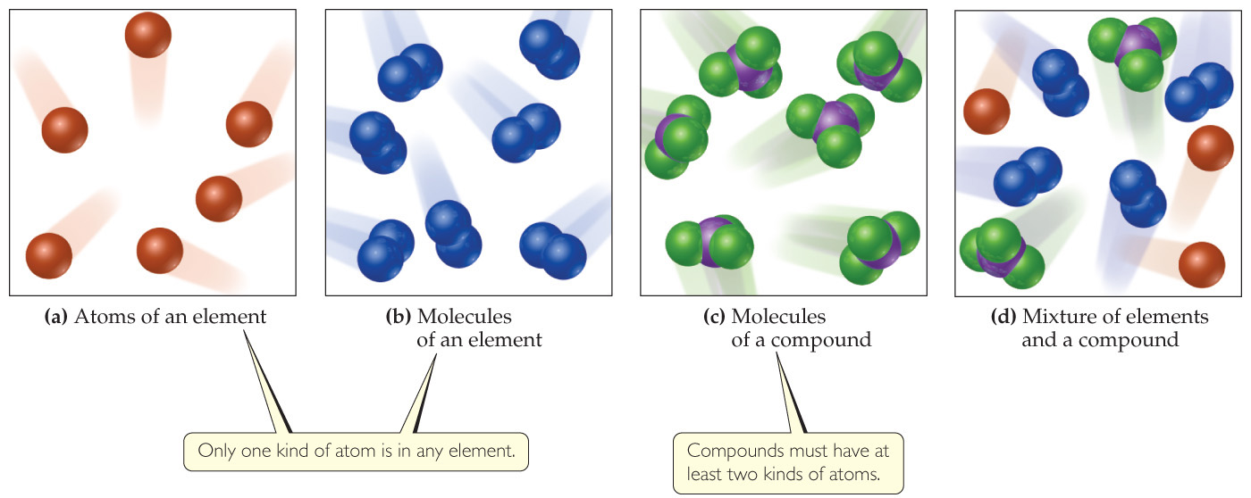
Classification of Matter Based on Composition
(Pure) Substance
纯净物
Mixture
混合物
Element
单质
Compound
化合物
Homogeneous
Heterogeneous
Notes:
Summary

Slide 16
Classification of Matter—Substances
A substance has distinct properties and a composition that does not vary from sample to sample.
The two types of substances are elements and compounds.
An element is a substance which can not be decomposed to simpler substances.
A compound is a substance which can be decomposed to simpler substances.

Slide 17
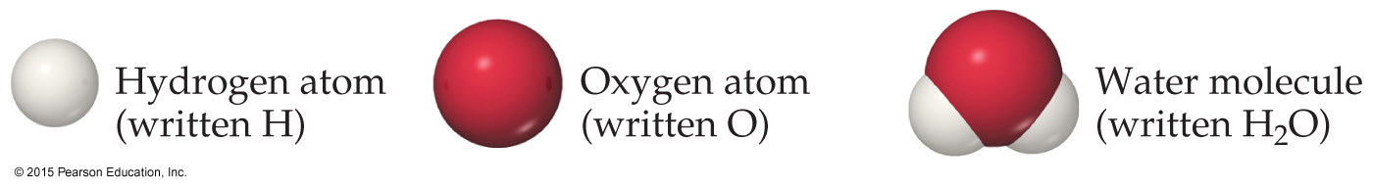
Compounds and Composition
Compounds have a definite composition. That means that the relative number of atoms of each element that makes up the compound is the same in any sample.
This is The Law of Constant Composition (or The Law of Definite Proportions 定比定律).
Notes:
固定组成定律

Slide 18
Classification of Matter—Mixtures
Mixtures exhibit the properties of the substances that make them up.
Mixtures can vary in composition throughout a sample (heterogeneous) or can have the same composition throughout the sample (homogeneous).
Another name for a homogeneous mixture is solution.

Slide 19
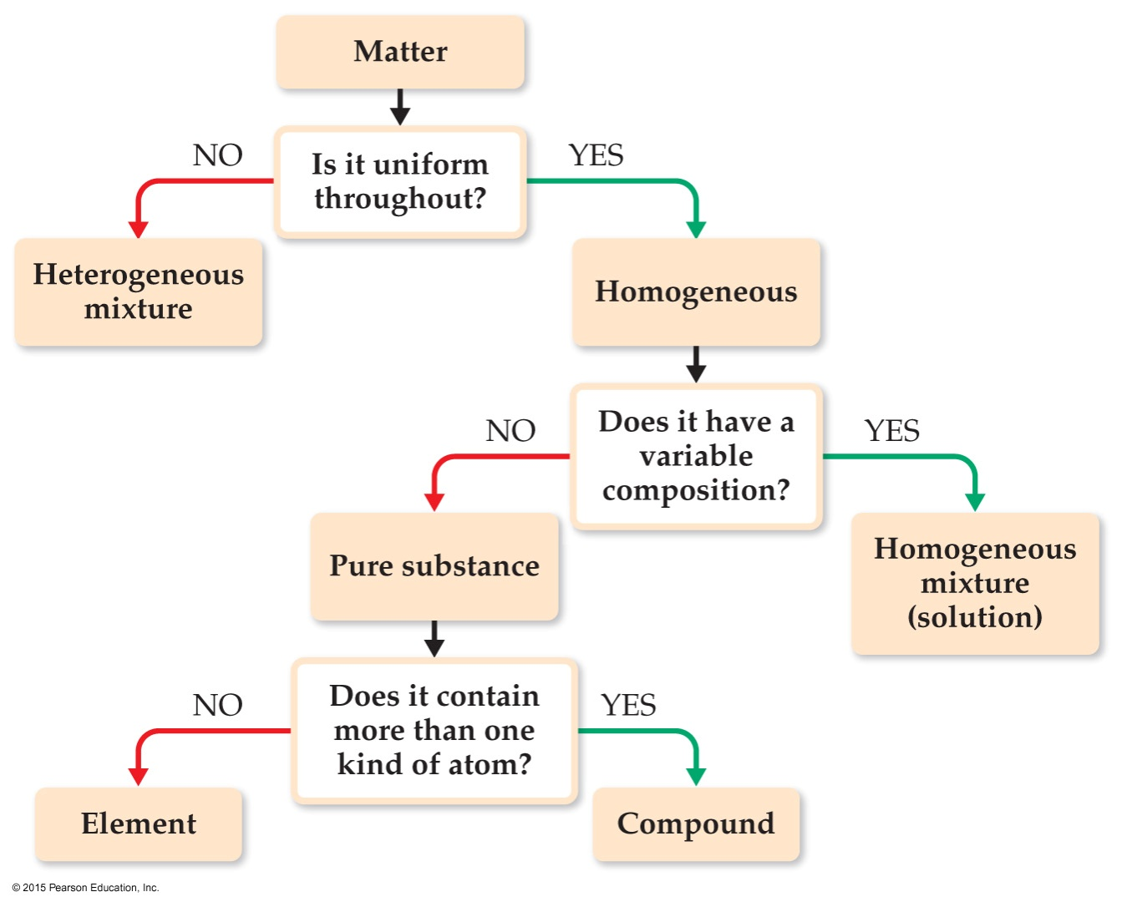

Classification of Matter Based on Composition
If you follow this scheme, you can determine how to classify any type of matter.
Homogeneous mixture
Heterogeneous mixture
Element
Compound
Matter
And
Measurement

Slide 20
Apple juice is an example of a(an)
element.
compound.
homogeneous mixture.
heterogeneous mixture.
Notes:
Answer: c

Slide 21
Apple juice is an example of a(an)
element.
compound.
homogeneous mixture.
heterogeneous mixture.
Notes:
Answer: c

Slide 22
Which of the following is not a pure substance?
water
carbon dioxide
carbon
air
Notes:
Answer: d

Slide 23
Which of the following is not a pure substance?
water
carbon dioxide
carbon
air
Notes:
Answer: d

Slide 24
Solutions may be
solids.
liquids.
gases.
All of the above
Notes:
Answer: d

Slide 25
Solutions may be
solids.
liquids.
gases.
All of the above
Notes:
Answer: d

Slide 26
Types of Properties
Physical Properties can be observed without changing a substance into another substance.
Some examples include boiling point, density, mass, or volume.
Chemical Properties can only be observed when a substance is changed into another substance.
Some examples include flammability, corrosiveness, or reactivity with acid.

Slide 27
Types of Properties
Intensive Properties (强度性质)
are independent of the amount of the substance that is present.
Examples include density, boiling point, or color.
Extensive Properties (广延性质)
depend upon the amount of the substance present.
Examples include mass, volume, or energy.

Slide 28
Types of Changes
Physical Changes are changes in matter that do not change the composition of a substance.
Examples include changes of state, temperature, and volume.
Chemical Changes result in new substances.
Examples include combustion, oxidation, and decomposition.

Slide 29

Changes in State of Matter
Converting between the three states of matter is a physical change.
When ice melts or water evaporates, there are still 2 H atoms and 1 O atom in each molecule.

Slide 30
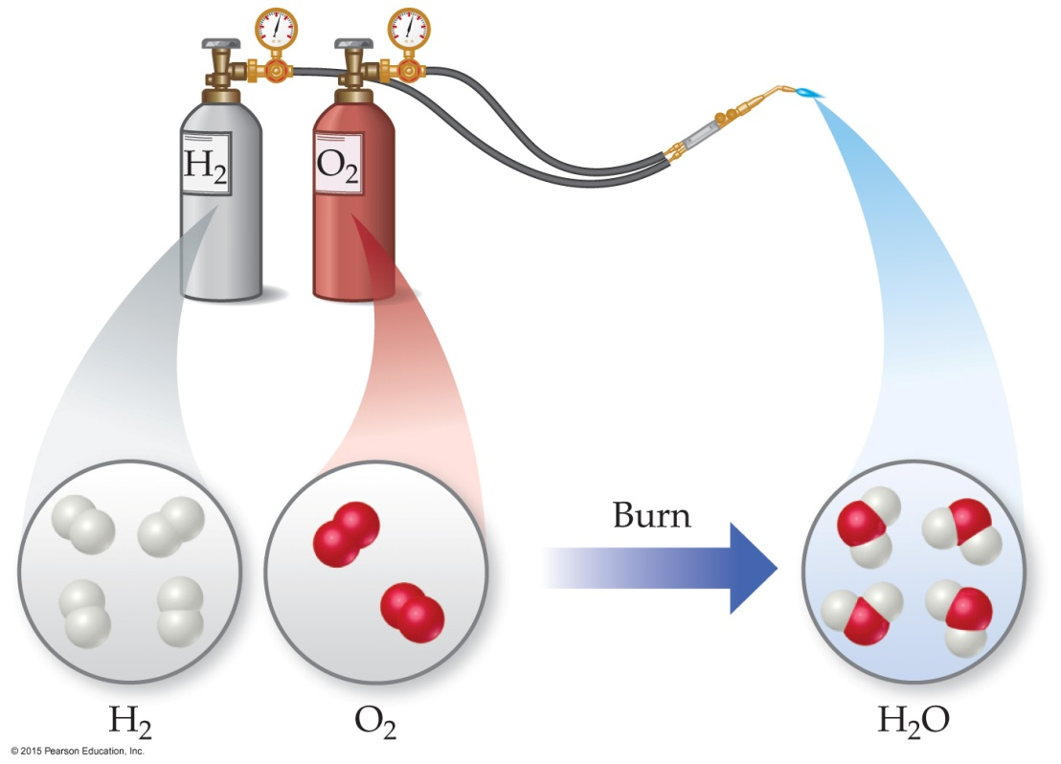
Chemical Reactions (Chemical Change)
In the course of a chemical reaction, the reacting substances are converted to new substances.
Here, the elements hydrogen and oxygen become water.

Slide 31
Separating Mixtures
Mixtures can be separated based on physical properties of the components of the mixture. Some methods used are
filtration.
distillation.
chromatography.

Slide 32
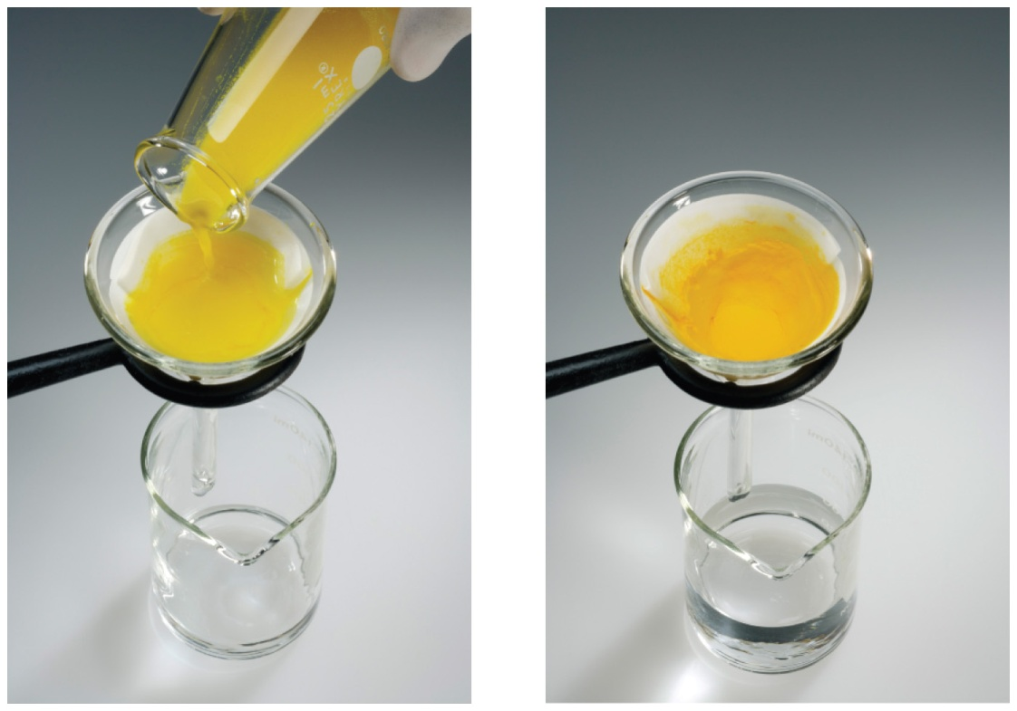
Filtration (过滤)
In filtration, solid substances are separated from liquids and solutions.

Slide 33
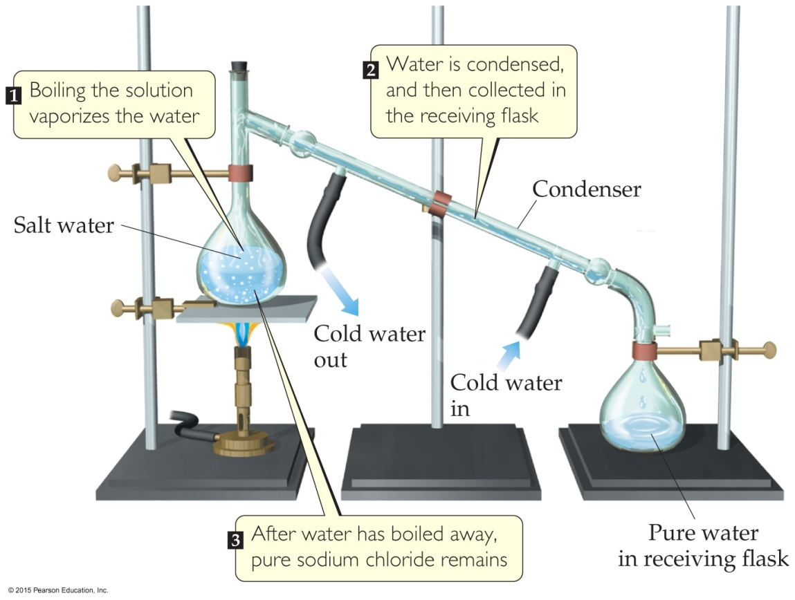
Distillation (蒸馏)
Distillation uses differences in the boiling points of substances to separate a homogeneous mixture into its components.

Slide 34
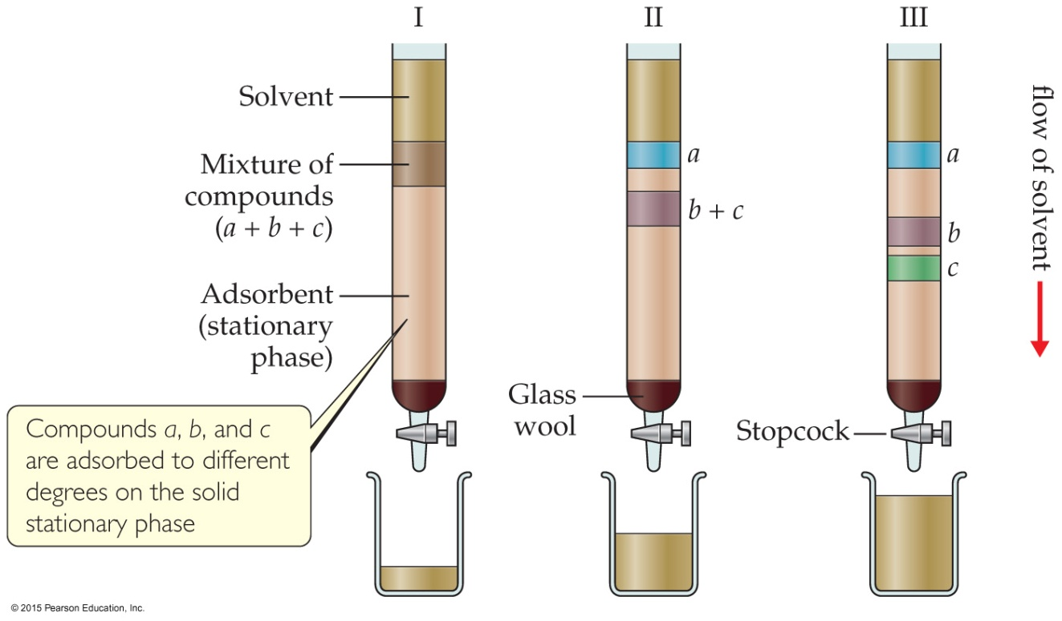
Chromatography (色谱)
This technique separates substances on the basis of differences in the ability of substances to adhere to the solid surface.

Slide 35
Descriptions of a sample that are based on the amount of substance are called
physical properties.
chemical properties.
intensive properties.
extensive properties.
Notes:
Answer: d

Slide 36
Descriptions of a sample that are based on the amount of substance are called
physical properties.
chemical properties.
intensive properties.
extensive properties.
Notes:
Answer: d

Slide 37
Properties that describe the way a substance reacts to form other substances are called
physical properties.
chemical properties.
homogeneous properties.
heterogeneous properties.
Notes:
Answer: b

Slide 38
Properties that describe the way a substance reacts to form other substances are called
physical properties.
chemical properties.
homogeneous properties.
heterogeneous properties.
Notes:
Answer: b

Slide 39
Acetic acid that was liquid when stored was solid when a student looked for it on a cold morning. This illustrates
a change in solubility.
a chemical change.
an equilibrium state.
a physical change.
Notes:
Answer: d

Slide 40
Acetic acid that was liquid when stored was solid when a student looked for it on a cold morning. This illustrates
a change in solubility.
a chemical change.
an equilibrium state.
a physical change.
Notes:
Answer: d

Slide 41
A copper wire placed in a silver nitrate solution turns dark and “fuzzy.” This illustrates
an accident.
a chemical reaction.
an extensive property.
a physical change.
Notes:
Answer: b

Slide 42
A copper wire placed in a silver nitrate solution turns dark and “fuzzy.” This illustrates
an accident.
a chemical reaction.
an extensive property.
a physical change.
Notes:
Answer: b

Slide 43
A solution with a boiling point of 105 degrees Celsius contains either sugar or salt. How would you determine which is present?
distill the solution
filter the solution
use chromatography
taste the solution
Notes:
Answer: a

Slide 44
A solution with a boiling point of 105 degrees Celsius contains either sugar or salt. How would you determine which is present?
distill the solution
filter the solution
use chromatography
taste the solution
Notes:
Answer: a

Slide 45
Numbers and Chemistry
Numbers play a major role in chemistry. Many topics are quantitative (have a numerical value).
Exact number (1 dozen = 12, 1 kg = 1000 g = 2.2046 lb.,
the number of people)
Inexact number ( numbers obtained by measurement)
Concepts of numbers in science
Units of measurement
Quantities that are measured and calculated
Uncertainty in measurement
Significant figures (有效数字)
Dimensional analysis (量纲分析)

Slide 46
Units of Measurement—Metric System (公制计量法)
The units used for scientific measurements are of those of the metric system.
It was developed in France and is used as the system of measurement in most countries.
The United States still uses the traditional English system.
Notes:
公制计量法

Slide 47
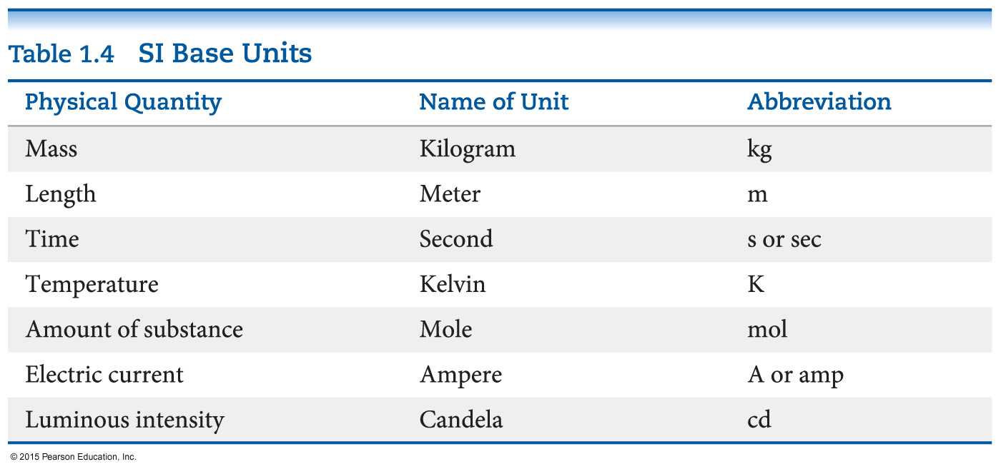
Units of Measurements—SI Units (国际计量单位)
Système International d’Unités (“The International System of Units”)
A different base unit is used for each quantity.
Notes:
What is the SI unit for the physical quantity of mass?
Base units 基本单位

Slide 48
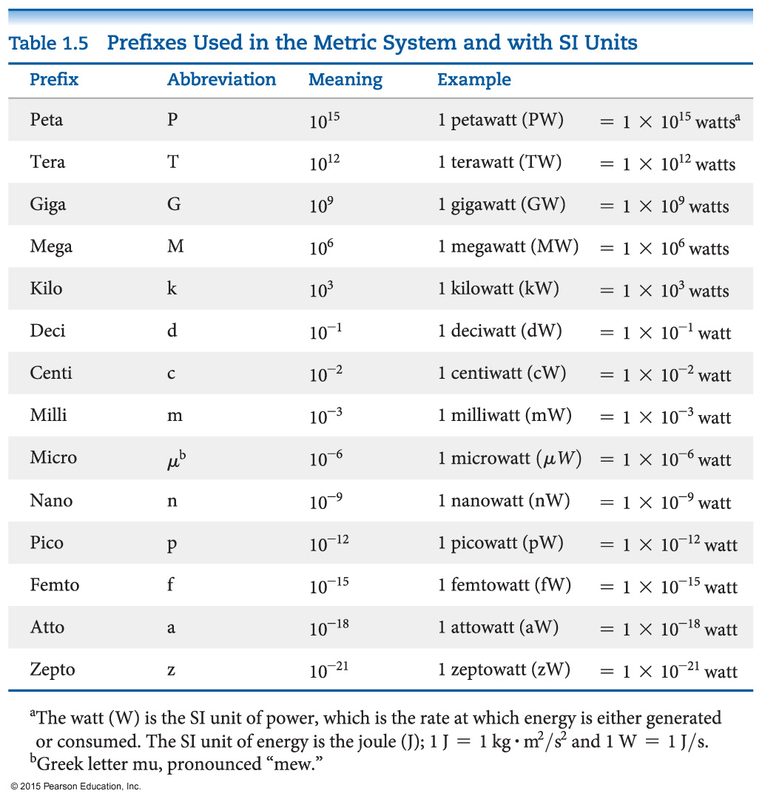
Units of Measurement— Prefixes in Metric System with SI units
Prefixes convert the base units into units that are appropriate for common usage or appropriate measure.

Slide 49
Mass and Length
These are basic units we measure in science.
Length is a measure of distance. The meter is the base unit.
Mass is a measure of the amount of material in an object. SI uses the kilogram as the base unit. The metric system uses the gram as the base unit.

Slide 50
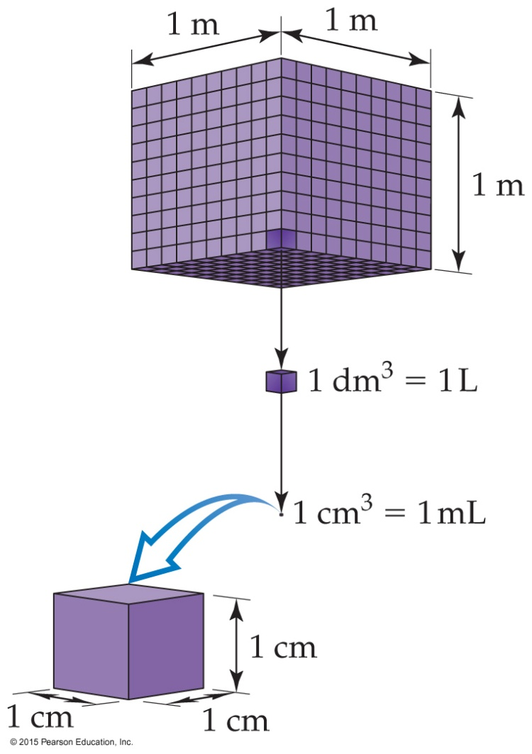
Volume
Note that volume is not a base unit for SI; it is derived from length (m × m × m = m³). 导出单位
The most commonly used metric units for volume are the liter (L) and the milliliter (mL).
A liter is a cube 1 decimeter (dm) long on each side.
A milliliter is a cube 1 centimeter (cm) long on each side, also called 1 cubic centimeter (cm × cm × cm = cm³).

Slide 51
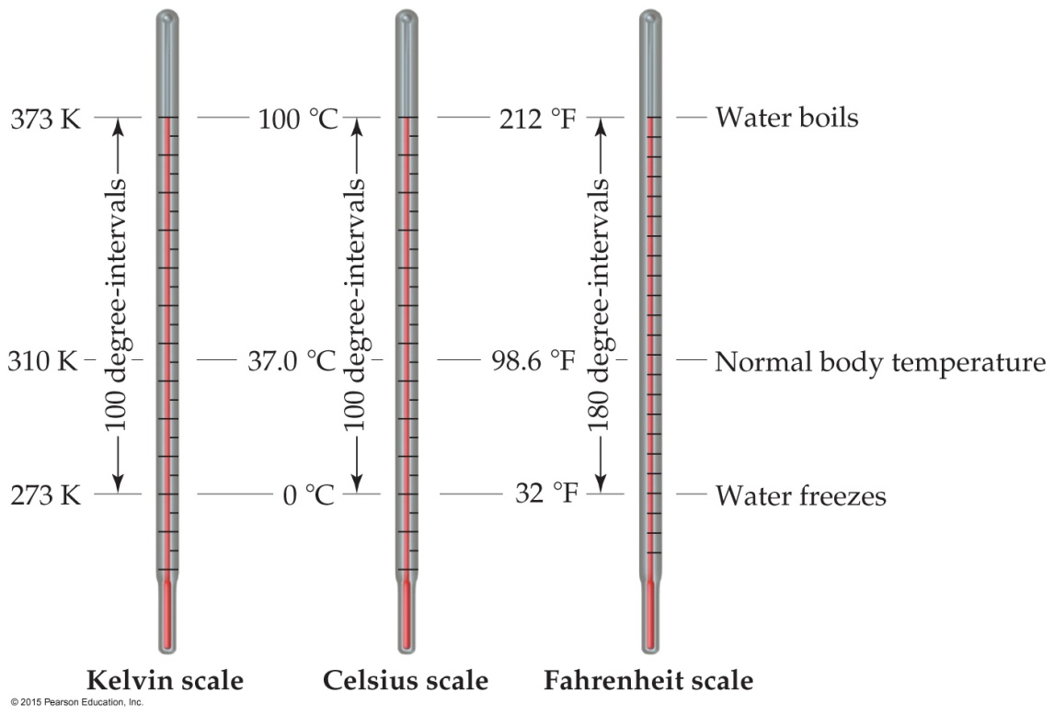
Temperature
In general usage, temperature is considered the “hotness and coldness” of an object that determines the direction of heat flow.
Heat flows spontaneously from an object with a higher temperature to an object with a lower temperature.
K ºC ºF
Notes:
Handshake

Slide 52
Temperature
In scientific measurements, the Celsius (摄氏) and Kelvin (开氏) scales are most often used.
The Celsius scale is based on the properties of water.
0 °C is the freezing point of water.
100 °C is the boiling point of water.
The Kelvin is the SI unit of temperature.
It is based on the properties of gases.
There are no negative Kelvin temperatures.
The lowest possible temperature is called absolute zero (0 K).
K = °C + 273.15

Slide 53
Temperature
The Fahrenheit scale (华氏) is not used in scientific measurements, but you hear about it in weather reports in US!
The equations below allow for conversion between the Fahrenheit and Celsius scales:
°F = 9/5(°C) + 32
°C = 5/9(°F − 32)

Slide 54
Density
Density is a physical property of a substance.
Density is defined as the amount of mass in a unit volume of a substance.
D = m/V
It has units that are derived from the units for mass and volume.
The most common units are g/mL or g/cm³.

Slide 55
Numbers Encountered in Science
Exact numbers (精确数) are counted or given by definition. For example, there are 12 eggs in 1 dozen.
Inexact (or measured) numbers depend on how they were determined. Scientific instruments have limitations. Some balances measure to ±0.01 g; others measure to ±0.0001g.
Notes:
The number of students

Slide 56
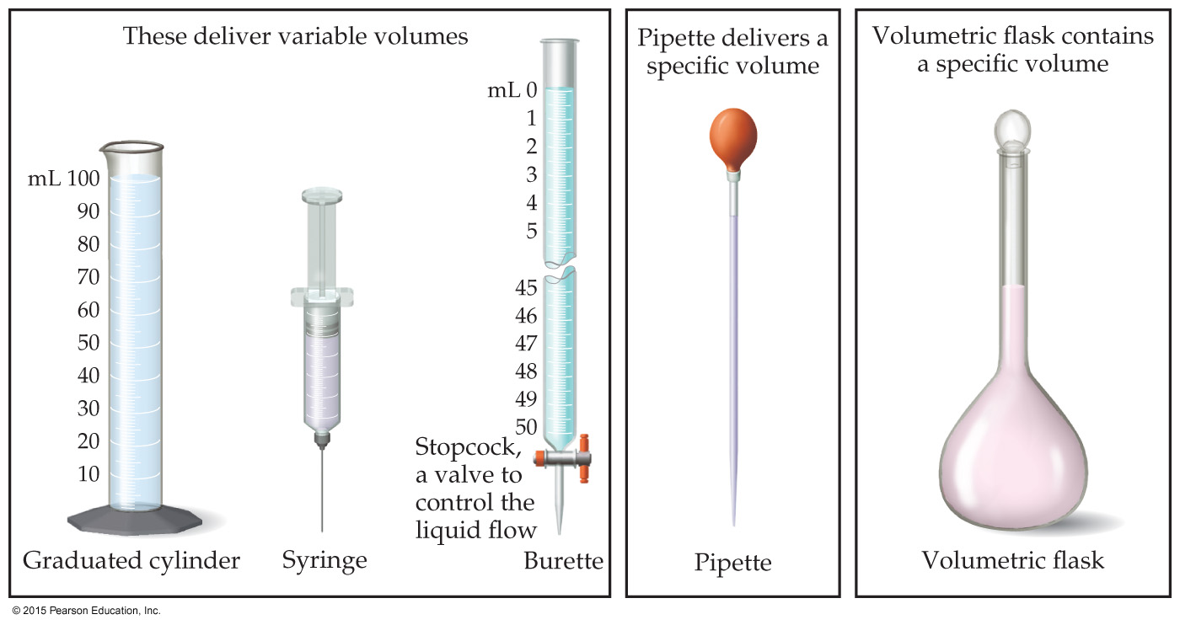
Uncertainty in Measurements
Different measuring devices have different uses and different degrees of accuracy (?).
All measured numbers have some degree of inaccuracy.

Slide 57
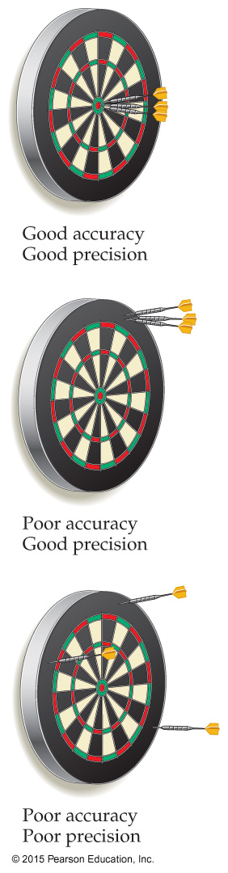
Accuracy versus Precision
Accuracy (准确度) refers to the proximity of a measurement to the true value of a quantity.
Precision (精密度) refers to the proximity of several measurements to each other.

Slide 58
Significant Figures (有效数字)
The term significant figures refers to digits that were measured.
When rounding calculated numbers, we pay attention to significant figures so we do not overstate the accuracy of our answers.

Slide 59
Significant Figures (*)
All nonzero digits are significant.
Zeroes between two significant figures are themselves significant.
Zeroes at the beginning of a number are never significant.
Zeroes at the end of a number are significant if a decimal point is written in the number.
Sample Exercise 1.7

Slide 60
Significant Figures
When addition or subtraction is performed, answers are rounded to the least significant decimal place.
When multiplication or division is performed, answers are rounded to the number of digits that corresponds to the least number of significant figures in any of the numbers used in the calculation.
exact number ====
infinite number of significant figures
Sample exercise 1.8
Sample exercise 1.9

Slide 61
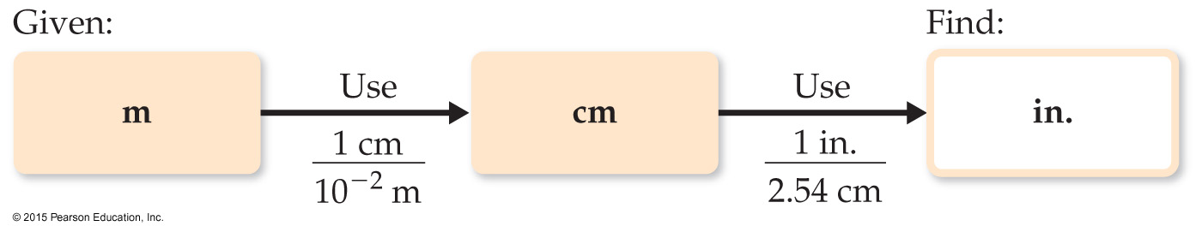
Dimensional Analysis (量纲分析)
We use dimensional analysis to convert one quantity to another.
Most commonly, dimensional analysis utilizes conversion factors (转换因子，e.g., 1 in. = 2.54 cm).
the equality either 1 in./2.54 cm or 2.54 cm/1 in.
We use the conversion factors which allows us to change units (puts the units we have in the denominator to cancel).

Slide 62
Dimensional Analysis (量纲分析)
desired unit
Given unit ×
=
desired unit
given unit
Use two or more conversion factors

Slide 63
In three trials, a student measures a sample’s mass to be 0.100 g, 0.600 g, and 0.300 g. The accepted value is 0.340 g. The student’s data have
good accuracy and good precision.
good accuracy, but poor precision.
poor accuracy, but good precision.
poor accuracy and poor precision.
Notes:
Answer: b

Slide 64
In three trials, a student measures a sample’s mass to be to be 0.100 g, 0.600 g, and 0.300 g. The accepted value is 0.340 g. The student’s data have
good accuracy and good precision.
good accuracy, but poor precision.
poor accuracy, but good precision.
poor accuracy and poor precision.
Notes:
Answer: b

Slide 65
The measured quantity 0.0860 g contains _____ significant figures.
three
four
five
six
Notes:
Answer: a

Slide 66
The measured quantity 0.0860 g contains _____ significant figures.
three
four
five
six
Notes:
Answer: a

Slide 67
4.1 g + 7.08 g = _____ g
11.180
11.18
11.2
11
Notes:
Answer: c

Slide 68
4.1 g + 7.08 g = _____ g
11.180
11.18
11.2
11
Notes:
Answer: c

Slide 69
6.9 g – 5.07 g = _____ g
1.830
1.83
1.8
1
Notes:
Answer: c

Slide 70
6.9 g – 5.07 g = _____ g
1.830
1.83
1.8
1
Notes:
Answer: c

Slide 71
5.2 cm × 7.01 cm = ____ cm²
36
36.4
36.45
36.452
Notes:
Answer: a

Slide 72
5.2 cm × 7.01 cm = ____ cm²
36
36.4
36.45
36.452
Notes:
Answer: a

Slide 73
6.03 g ÷ 7.1 mL = _____ g/mL
0.8
0.85
0.849
0.849257
Notes:
Answer: b

Slide 74
6.03 g ÷ 7.1 mL = _____ g/mL
0.8
0.85
0.849
0.849257
Notes:
Answer: b

Slide 75
Which unit is not an SI base unit?
kilogram
degree Celsius
meter
second
Notes:
Answer: b

Slide 76
Which unit is not an SI base unit?
kilogram
degree Celsius
meter
second
Notes:
Answer: b

